Slide 1
DATA SCIENCE Class 19: web development with flask / heroku

Slide 2
I. What is web development? iI. What is heroku / flask? III. mvc IV. Deploying knn
agenda

Slide 3
I. What is web development?
WHAT IS WEB DEVELOPMENT?

Slide 4
What is web development?
The work involved with building and maintaining a live website

Slide 5
What is web development?
Two types of web development:

Slide 6
What is web development?
Two types of web development:
Front-end Development
Back-end Development
HTML / CSS
Responsive design
Makes things pretty / easy to use
Many backend languages
Model View Controller
Database work
Makes the site “work”

Slide 7
What is web development?
Full-stack Development comprises of both front end
and back end work

Slide 8
What is web development?
Part of being a web developer is knowing the technologies used

Slide 9
What is web development?
Part of being a web developer is knowing the technologies used
Web-framework
Deployment
Consists of database work and logistics of the site
How we “serve” the website. So that other people can use it

Slide 10





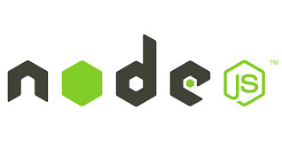

What is web development?
Web-framework
Deployment
Consists of database work and logistics of the site
How we “serve” the website. So that other people can use it

Slide 11
II. heroku / flask
HEROKU / FLASK

Slide 12
Heroku / flask
Web Development is hard..
Which is why GA has several classes dedicated to it
We will use two very simple web development tools:
Heroku and Flask

Slide 13

Heroku / flask
Did someone say Flask!?

Slide 14
Heroku / flask
Did someone say Flask!?
Flask is a micro-web-framework based entirely in python
What does that mean?
It means we can write the entire backend in Python!

Slide 15

Heroku / flask
Did someone say Heroku!?
Heroku is a Salesforce company that lets us deploy our websites easily
What does that mean?
We use heroku to rent servers to host the website

Slide 16
Heroku / flask
One thing that stays constant over all technologies is the idea of the
Model View Controller paradigm

Slide 17
III. Model View Controller
MODEL VIEW CONTROLLER

Slide 18
MODEL VIEW CONTROLLER
Model View Controller:

Slide 19
MODEL VIEW CONTROLLER
Model View Controller:
Is a way of life

Slide 20
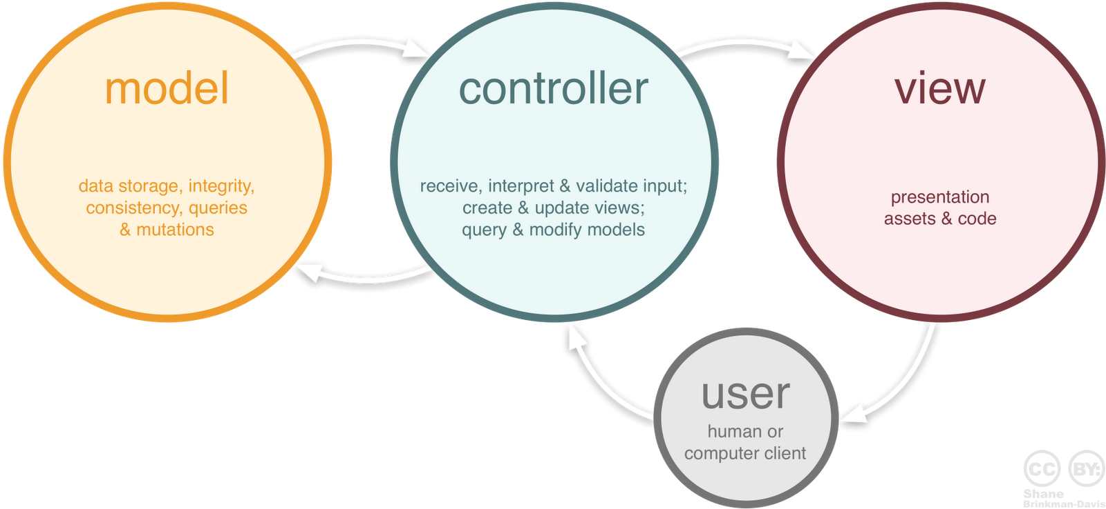
MODEL VIEW CONTROLLER
Model View Controller:
But actually it’s a software design pattern specifically for web apps
Source: http://www.essenceandartifact.com/2012/12/the-essence-of-mvc.html

Slide 21
MODEL VIEW CONTROLLER
Model View Controller:
Model
Responsible for managing the data
It’s a database essentially!
View
Presents the data / app
Responsible for design / user experience
Controller
Responds to user input and performs operations based on it
Eg. User inputs a number of neighbors and the controller trains the model

Slide 22

MODEL VIEW CONTROLLER
Model View Controller:
Model
Responsible for managing the data
It’s a database essentially!
View
Presents the data / app
Responsible for design / user experience
Controller
Responds to user input and performs operations based on it
Eg. User inputs a number of neighbors and the controller trains the model
QUESTION:
Which ones are handled by
Back end developers?
Front end?

Slide 23
MODEL VIEW CONTROLLER
Model View Controller:
Model (Backend)
Responsible for managing the data
It’s a database essentially!
View (Frontend)
Presents the data / app
Responsible for design / user experience
Controller (Backend / Frontend)
Responds to user input and performs operations based on it
Eg. User inputs a number of neighbors and the controller trains the model
QUESTION:
Which ones are handled by
Back end developers?
Front end?

Slide 24
IV. Deploying knn
DEPLOYING KNN

Slide 25
Deploying knn
Sample Flask App
https://github.com/sinanuozdemir/sinan_iris

Slide 26
Deploying knn
Sample Flask App
https://github.com/sinanuozdemir/sinan_iris
Notice we have:
Models
Views (called templates)
Controller (controller.py)

Slide 27
Deploying knn
Sample Flask App
https://github.com/sinanuozdemir/sinan_iris
Go ahead and clone it
NOT IN YOUR OTHER GIT REPOSITORY ☺

Slide 28
Deploying knn
Sample Flask App
https://github.com/sinanuozdemir/sinan_iris
To run locally, go to root and run
python controller.py
Go to http://127.0.0.1:5000/

Slide 29
Deploying knn
Sample Flask App
https://github.com/sinanuozdemir/sinan_iris
To run locally, go to root and run
python controller.py
Go to http://127.0.0.1:5000/
NOTE:
You may not have the required modules to run it right now..
If not, run
sudo pip install –r requirements_clean.txt

Slide 30
Deploying knn
We have two forms
The top form trains the model
The bottom form predicts incoming data
When we submit the data Which part of MVC handles the input?

Slide 31
Deploying knn
We have two forms
The top form trains the model
The bottom form predicts incoming data
When we submit the data the controller handles it!

Slide 32
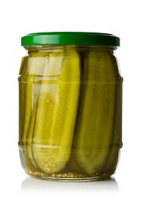
Deploying knn
The machine learning model lives in the folder
It is pickled…

Slide 33
Deploying knn
The machine learning model lives in the model folder
not to be confused with the model in MVC
It is pickled…
You know, the standard mechanism
for serializing an object.
Essentially we can transform a
python object into a file!

Slide 34


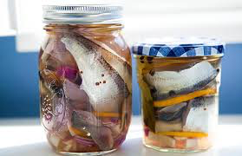
Deploying knn
You can pickle anything!!
sklearn models
Jsons!
Strings!
Your own models
Any python object can be pickled

Slide 35
Deploying knn
Comprehensive Step by Step
Sign up for Heroku here
Create a new app (make sure Heroku toolbelt is installed)
Clone our flask app here
Change and test at will
Run the command: heroku git:remote –a <APP>
Install the custom build back for scipy and numpy (this installs sklearn)
heroku config:set BUILDPACK_URL=https://github.com/thenovices/heroku-buildpack-scipy --app <APP>
Run the command above in the root of your app (with the toolbelt installed)
Use as normal git repository:
git add, commit, etc...
git push heroku master (instead of origin)
Amaze people with your mad data science skillz

Slide 36
1. Sign up for Heroku
Deploying knn
Self-explanatory?
http://heroku.com

Slide 37
2. Create a new app (make sure Heroku toolbelt is installed)
Deploying knn
Not self-explanatory
1. https://toolbelt.heroku.com/
2. Type into your console:
heroku login

Slide 38
3. Clone our flask app here
Deploying knn
Self-explanatory?
Now you can run it locally!! (python controller.py)

Slide 39
4. Run the command: heroku git:remote –a <APP>
Deploying knn
At the root of the directory
This adds a new git “remote”
A new place to push
Check this by running git remote –v
You should see origin and heroku

Slide 40
5. Install the custom build back for scipy and numpy
Deploying knn
Not self-explanatory. This will install sklearn directly on our rented servers
https://github.com/thenovices/heroku-buildpack-scipy
Run:
heroku config:set BUILDPACK_URL=https://github.com/thenovices/heroku-buildpack-scipy --app <APP>
At the root of the directory

Slide 41
6. Use as normal git repository
Deploying knn
Self-explanatory?
git add .
git commit –m “I am a genius”
Git push heroku master

Slide 42
6. Use as normal git repository
Deploying knn
Self-explanatory?
git add .
git commit –m “I am a genius”
Git push heroku master
Note:
It is installing a bunch of modules because of the requirements.txt file

Slide 43





7. Amaze people with your mad data science skillz
Deploying knn
Self-explanatory!!!!!

Slide 44
WHAT NOW?!!?!?!!1?
Deploying knn
Put in your own machine learning model!
But Sinaaaaan, it’s too hard to make it train on the website because I am a genius and am ensembling so many things and stuff
Fine!
Build your model elsewhere (in an ipython notebook)
Pickle your model
Load it into the model folder manually

Slide 45
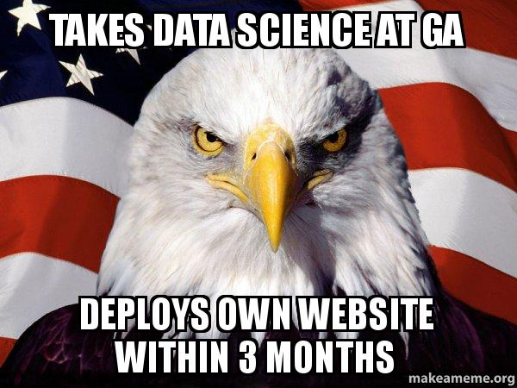
Deploying knn
Note:
Your unique website will have your app name instead of sinan-iris
http://sinan-iris.herokuapp.com/

